Slide 1
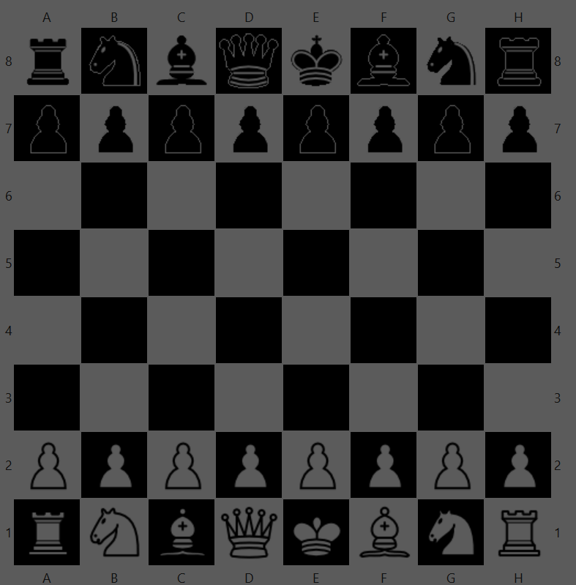
CheckMate
Team 11
Colin Johnson, Jiwon Seo, Kaichun Lee, Megan Herzog

Slide 2
Table of Contents
How to play Chess?
What is the rule of each pieces?
When does game ends?
Wow Factor?
Conclusion

Slide 3

How to play Chess?
To start off, click on “play” button on eclipse, and open 2 windows.
For each window, click “new game” to start with “server side” and “client side”
Video link

Slide 4






What is the rule?
Pawn King
Knight Queen
Bishop
Rook
Notes:
Pawn moves 2 only 1st move, otherwise, move 1 step. When there’s enemy on diagonal side, it’s able to move and attach enemy
En passant: when white moves two steps forward, and when black was move diagonal one stpe, but if the white’s passage was on the black way, then it can attack.
Knight :
King: King can move one square around itself.
Queen: can move one direction with unlimited steps.
Bishop: diagonal
Rook: horizontal or vertical
Knight: L shape pattern, can jump pieces. (only the knight jump pieces) 8 possible position.

Slide 5
Rule of Pawn
1st Move: can move forward 2 steps or 1 step.
2nd move~: can move forward 1 step.
Enemy on diagonal: possibly Attack!
En Passant: When a pawn uses their double move on their first move, a neighboring pawn can attack that pawn as if it was diagonal to it.

Slide 6

En Passant
When a pawn uses their double move on their first move, a neighboring pawn can attack that pawn as if it was diagonal to it.

Slide 7
Rule of Knight
Move in L Shape and is the only piece able to jump over others

Slide 8
Rule of Bishop:
Rule of Rook:
Can Move diagonal direction unlimited number of steps when it’s empty
Cannot jump over pieces.
Can Move Horizontal/Vertical direction unlimited number of steps when the board is empty
Cannot jump over pieces.

Slide 9
Rule of King :
King can move only one steps at a time around its surroundings.

Slide 10
Special Rule: Castle
The Castle is a move performed by both the Rook and the King.
A King can Castle to either the left side or right side.
Both Pieces can not of been moved, i.e. they are the first move of the King and Rook
All spaces between the Rook and the King must be open
Left Side Castle
Right Side Castle

Slide 11
Rule of Queen:
Queen can move any one direction with unlimited steps if the board is empty.
Queen cannot jump over pieces.

Slide 12
When does the game ends?
Check: Warning sign that king is attacked by enemy.
The King Must get out of check by moving
CheckMate: Ending sign that King is attached by any pieces which cannot be get out of that losing situation.
When the game reaches checkmate, the game is over.
Notes:
Check warning
Checkmate: ending

Slide 13
Wow factor: Help page on the menu item
We decided to make a help page for “Rule”.
When players are playing the game, they are able to look at the help page to choose the board they want.
Regarding the possible position they can move, we provide the guideline on red dot.

Slide 14
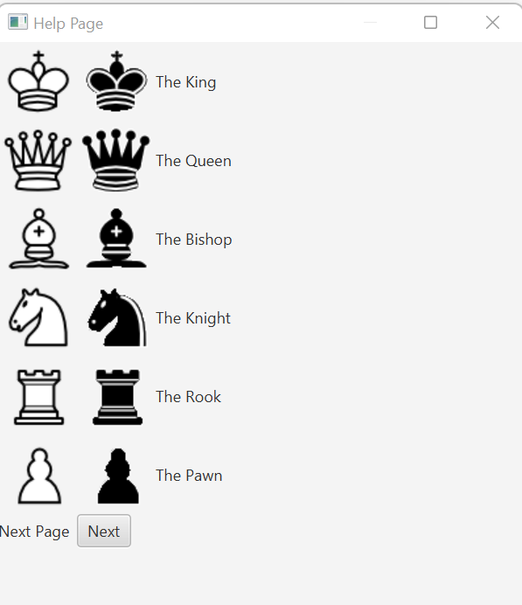
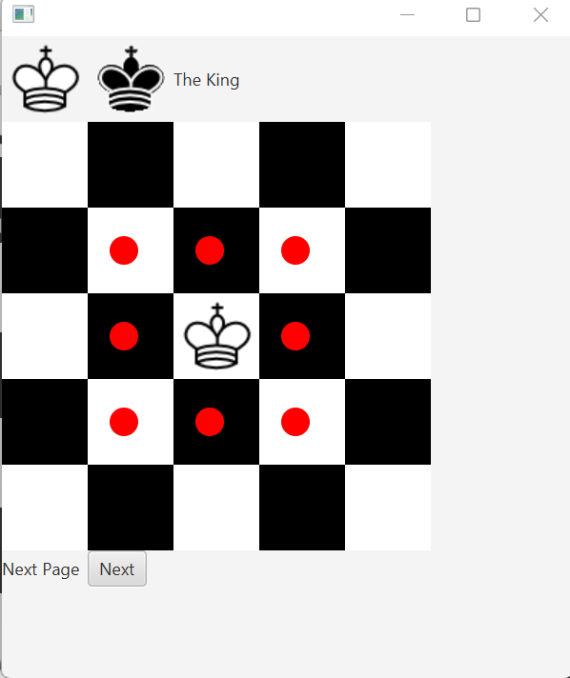
First, Second help page

Slide 15
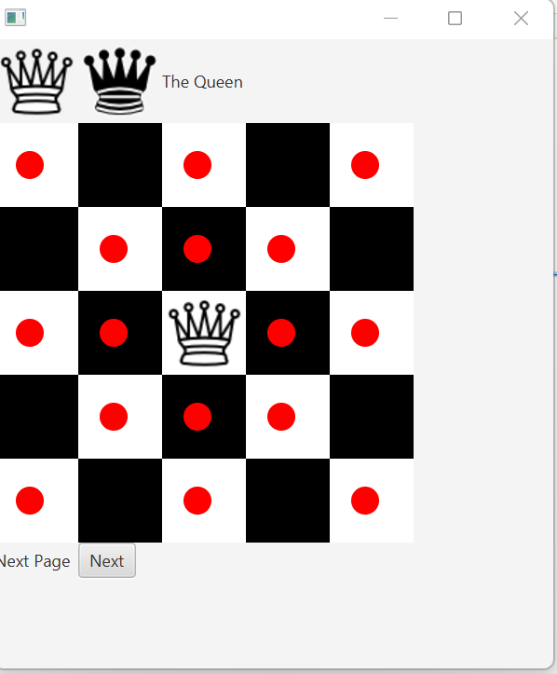
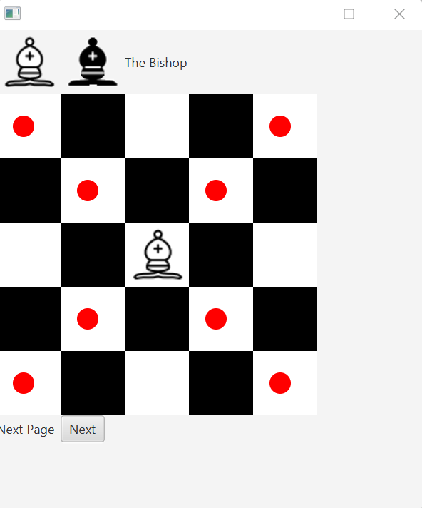
Third and Fourth help page.

Slide 16
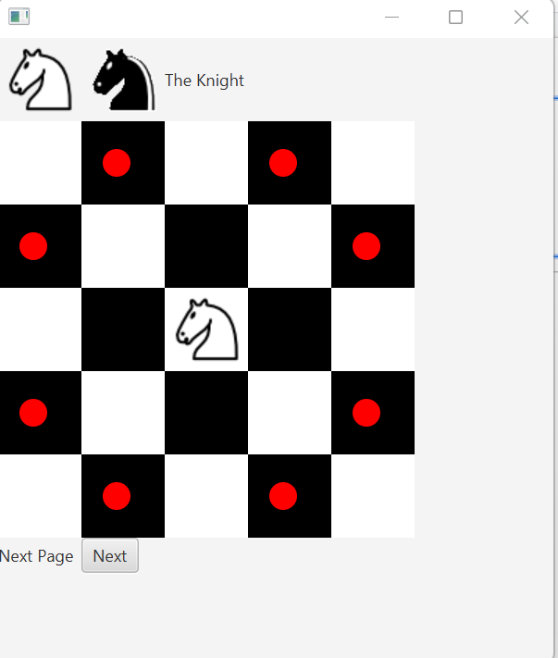
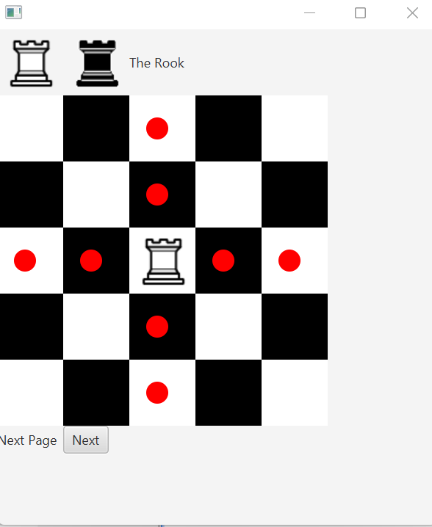
Fifth and Sixth help page

Slide 17
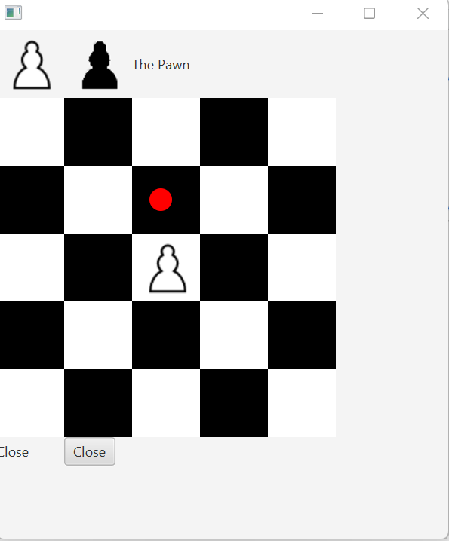
Seventh help page

Slide 18
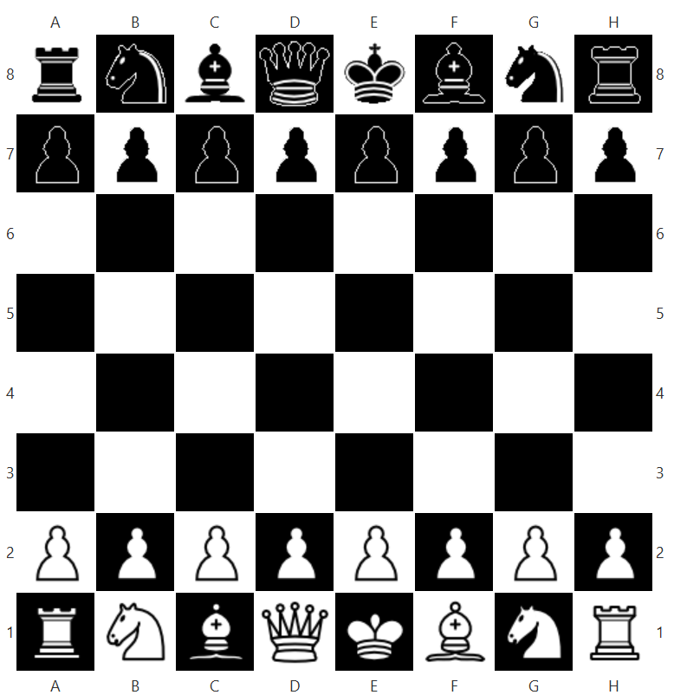
Thank You!
It was Team 11 for Chess Game.

